Slide 1
Biology Week Quiz Questions
Ages 13-15

Slide 2
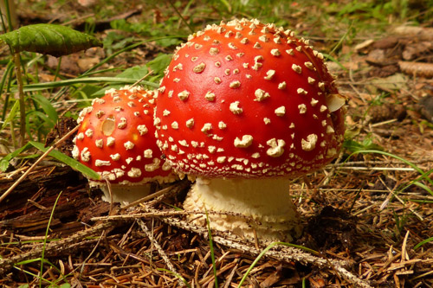
Question 1.
True or False?
Some species of fungi glow in the dark
(1 mark)
Notes:
Answer: True – known as bioluminescent fungi, the light is thought to be used to attract insects

Slide 3
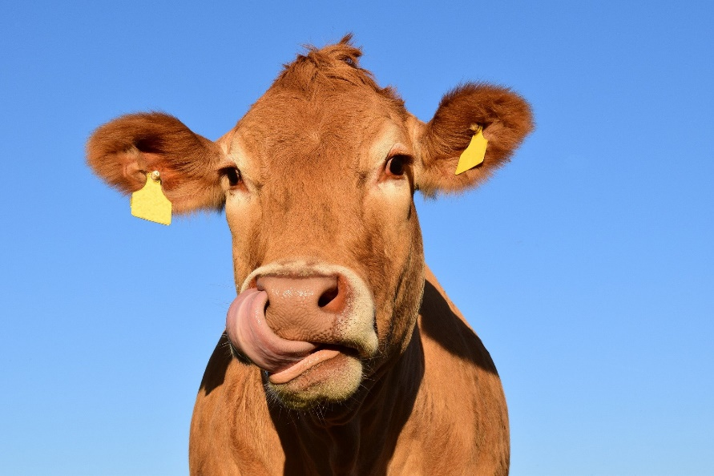
Question 2.
How many stomachs does a cow have?
1
2
3
4
(1 mark)
Notes:
Answer: 4

Slide 4
Question 3.
Can you match these three famous scientists to their areas of expertise?
Watson and Crick
Edward Jenner
Jane Goodall
(3 marks)
Creation of vaccines
Structure of DNA
Primatology
Notes:
Answer:
Watson and Crick – structure of DNA
Edward Jenner – creation of vaccines (smallpox)
Jane Goodall – primatology

Slide 5
Question 4.
Name the structures of this plant cell:
Cell wall
Vacuole
Cytoplasm
Chloroplast
(4 marks)
Notes:
Answer:
Left side, from top to bottom: cytoplasm, vacuole
Right side, from top to bottom: cell wall, chloroplast

Slide 6
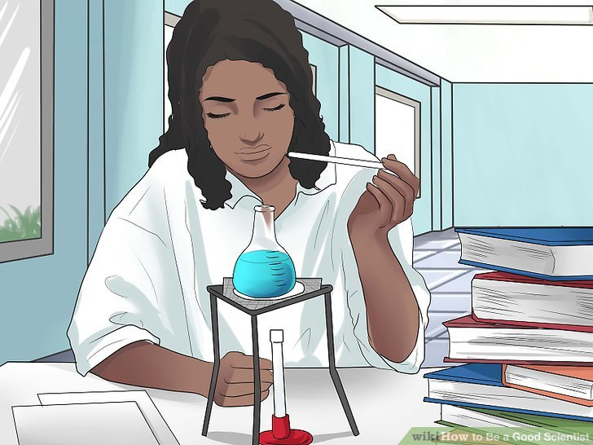
Question 5.
If you work as an endocrinologist, what area of biology do you specialise in?
(1 mark)
Notes:
Answer: The hormonal systems

Slide 7
Question 6.
What percentage of each gas is our atmosphere made up of?
Nitrogen
Oxygen
Argon
(3 marks)
78%
1%
21%
Notes:
Answer:
Nitrogen – 78%
Oxygen – 21%
Argon – 1%

Slide 8
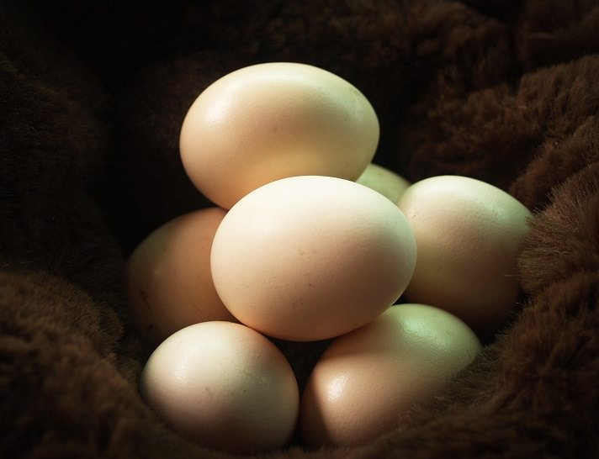
Question 7.
True or False?
Some mammals lay eggs
(1 mark)
Notes:
Answer: True – these are known as monotremes and consist of the platypus and the echidna

Slide 9
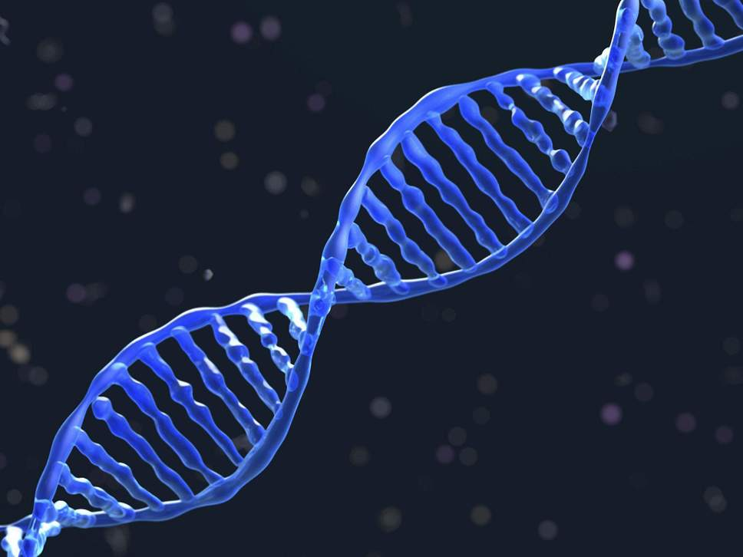
Question 8.
What percentage of human DNA is identical in every individual?
0.1%
45%
99.9%
(1 mark)
Notes:
Answer: 99.9%

Slide 10
Question 9.
Which animal group contains the largest number of individual organisms?
(1 mark)
Notes:
Answer: Insects

Slide 11
Question 10.
Approximately how many more bacterial cells are there in your body than your own cells?
1.5 times more
5 times more
10 times more
100 times more
(1 mark)
Notes:
Answer: 10 times more

Slide 12
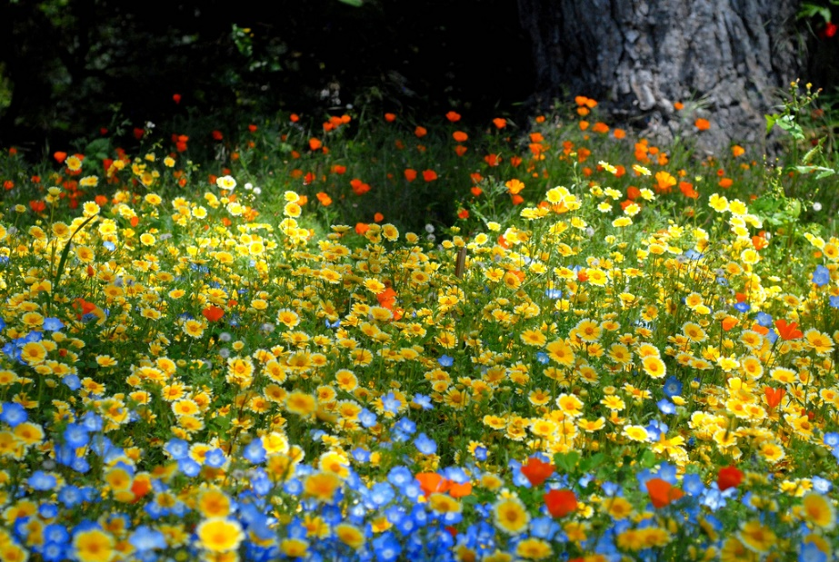
Question 11.
Which of these native UK flowers is poisonous to animals?
Buttercup
Bluebell
Snowdrop
(1 mark)
Notes:
Answer: Buttercup

Slide 13
Question 12.
What is the common name for the species Panthera leo?
(1 mark)
Notes:
Answer: Lion

Slide 14
Question 13.
In cold weather, in humans and animals, hairs stand on end to trap ________
(1 mark)
Notes:
Answer: Air (to act as insulation)

Slide 15
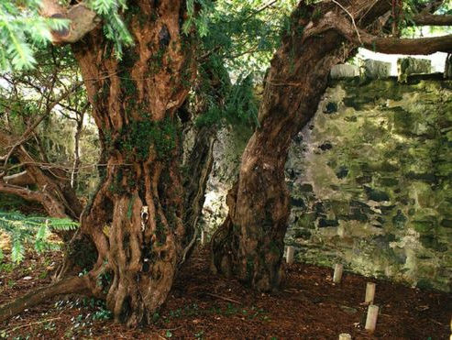
Question 14.
The oldest tree in the UK is the Fotingall Yew in Perthshire. How old is the tree?
500-900 years old
1000-2750 years old
4000-9000 years old
(1 mark)
Notes:
Answer: 4000-9000 years old

Slide 16
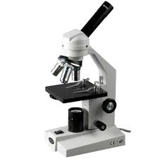
Question 15.
What is the smallest measurement a light microscope can see?
(1 mark)
Notes:
Answer: 0.2µm (micrometres), 2x10⁻⁷

Slide 17
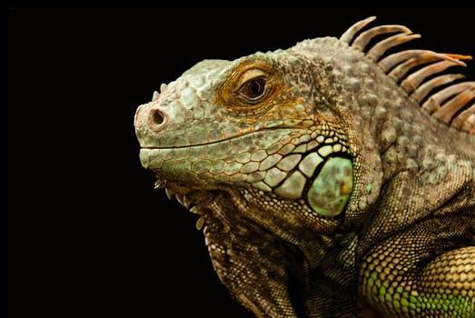
Question 16.
Approximately how many species of lizards are there in the world?
Less than 1000
1000-2000
3000-6000
Over 6000
(1 mark)
Notes:
Answer: 3000-6000 (there are currently over 4,500 known species of lizard)

Slide 18
Question 17.
What does an ichthyologist study?
(1 mark)
Notes:
Answer: Fish

Slide 19
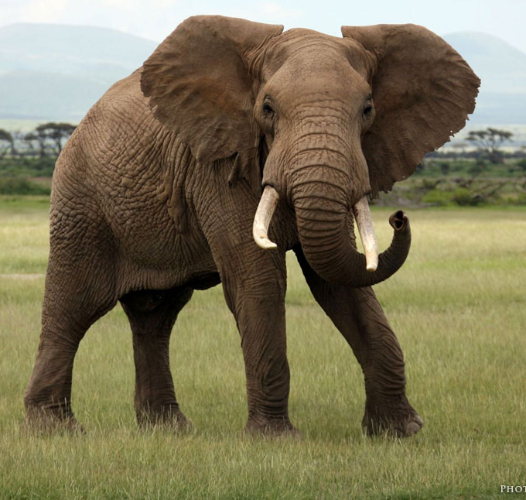
Question 18.
True or false?
Elephants are herbivores
(1 mark)
Notes:
Answer: True

Slide 20
Question 19.
Which species has the greatest number of genes?
a) Chimpanzees
b) Humans
c) Mice
d) Rice
(1 mark)
Notes:
Answer:
Rice (50,900)
Chimpanzees have 20,800
Humans have 23,600
Mice have 23,100

Slide 21
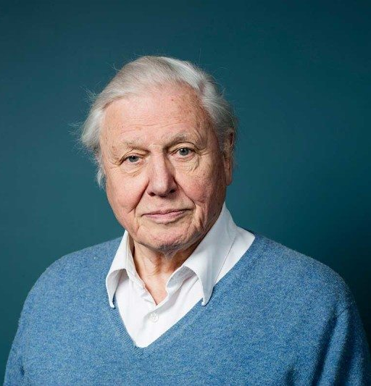
Question 20.
What did Sir David Attenborough study at university?
(1 mark)
Notes:
Answer:
Natural sciences (geology and zoology)

Slide 22
27
How did you do?
Follow us on Twitter @RoyalSocBio using the hashtag #BiologyWeek to let us know!
Download more Biology Week resources:
https://www.rsb.org.uk/get-involved/biologyweek

